Slide 1

Data Structures Using C++ 2E
Chapter 3
Pointers and Array-Based Lists

Slide 2
Objectives
Learn about the pointer data type and pointer variables
Explore how to declare and manipulate pointer variables
Learn about the address of operator and dereferencing operator
Discover dynamic variables
Examine how to use the new and delete operators to manipulate dynamic variables
Learn about pointer arithmetic
Data Structures Using C++ 2E

Slide 3
Objectives (cont’d.)
Discover dynamic arrays
Become aware of the shallow and deep copies of data
Discover the peculiarities of classes with pointer data members
Explore how dynamic arrays are used to process lists
Learn about virtual functions
Become aware of abstract classes
Data Structures Using C++ 2E

Slide 4
The Pointer Data Type and Pointer Variables
Pointer data types
  Values are computer memory addresses
  No associated name
  Domain consists of addresses (memory locations)
Pointer variable
  A variable whose content is an address (memory address)
Data Structures Using C++ 2E

Slide 5
The Pointer Data Type and Pointer Variables (cont’d.)
Declaring pointer variables
  Specify data type of value stored in the memory location that pointer variable points to
  General syntax
    dataType *identifier;
  Asterisk symbol (*)
    Between data type and variable name
    Can appear anywhere between the two
    Preference: attach * to variable name
  Examples:
    int *p; char *ch;
    int *a, b; // only a is pointer, b is not
Data Structures Using C++ 2E

Slide 6
The Pointer Data Type and Pointer Variables (cont’d.)
Address of operator (&)
  Unary operator
  Returns address of its operand
  int *a, b; a = &b;
Dereferencing operator (*)
  Unary operator
    Different from binary multiplication operator
  Also known as indirection operator
  Refers to object where the pointer points
  int *a, b; a = &b; *a = 5;
Data Structures Using C++ 2E

Slide 7
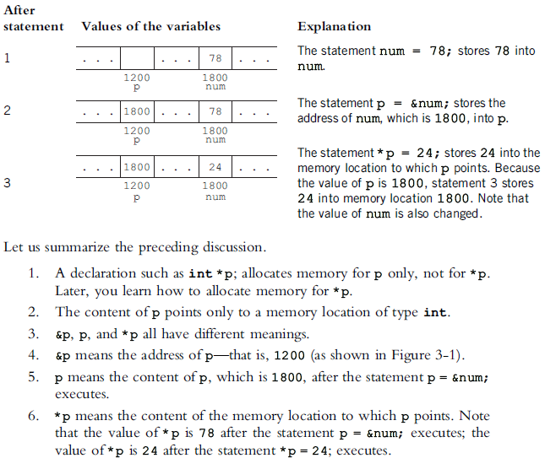



The Pointer Data Type and Pointer Variables (cont’d.)
Data Structures Using C++ 2E

Slide 8
The Pointer Data Type and Pointer Variables (cont’d.)
Pointers and classes
  Dot operator (.)
    Higher precedence than dereferencing operator (*)
  Member access operator arrow ( ->)
    Simplifies access of class or struct components via a pointer
    Consists of two consecutive symbols: hyphen and ‘‘greater than’’ symbol
  Syntax
    pointerVariableName -> classMemberName
(*pointerVariableName).classMemberName
Data Structures Using C++ 2E

Slide 9
The Pointer Data Type and Pointer Variables (cont’d.)
string *str;
str = new string;
*str = "Hello World";
// the meaning of
// (*str).length()
// *str.length()
// str->length()
cout << "length = " << (*str).length();
cout << "length = " << str->length();
Compilation error: left of .length must have class/struct/union
Data Structures Using C++ 2E

Slide 10
The Pointer Data Type and Pointer Variables (cont’d.)
Initializing pointer variables
  No automatic variable initialization in C++
  Pointer variables must be initialized
    If not initialized, they do not point to anything
  Initialized using
    Constant value 0 (null pointer)
    Named constant NULL
  Number 0
    Only number directly assignable to a pointer variable
  int *p;
  p = 0; p = NULL;
Data Structures Using C++ 2E

Slide 11
The Pointer Data Type and Pointer Variables (cont’d.)
Dynamic variables
  Variables created during program execution
    Real power of pointers
  Two operators
    new: creates dynamic variables
    delete: destroys dynamic variables
    Reserved words
    Use the matching one: new/delete, malloc/free
Data Structures Using C++ 2E

Slide 12
The Pointer Data Type and Pointer Variables (cont’d.)
Operator new
  Allocates single variable, or array of variables
  Syntax
    new dataType;
    new dataType[intExp];
  Allocates memory (variable) of designated type
    Returns pointer to the memory (allocated memory address)
    Allocated memory: uninitialized
Data Structures Using C++ 2E

Slide 13
The Pointer Data Type and Pointer Variables (cont’d.)
Operator delete
  Destroys dynamic variables
  Syntax
    delete ptrVariable;
    delete [] ptrArrayVariable;
  w/o delete ➔ memory leak (cannot be reallocated)
  Dangling pointers
    Pointer variables containing addresses of deallocated memory spaces
    Avoid by setting deleted pointers to NULL after delete
Data Structures Using C++ 2E

Slide 14
Example
#include <iostream>
using namespace std;
void main()
{
  cout << "hello world\n";
  int *a, b;
  a = &b;
  cout << "a = " << a << endl;
  cout << "&a = " << &a << endl;
  a = new int;
  cout << "a = " << a << endl;
  delete a;
  a = new int[10];
  cout << "a = " << a << endl;
  delete [] a;
}
Data Structures Using C++ 2E

Slide 15


Example 2
Code snippet
What is the problem with the above 4 lines?
  How to avoid it?
Example 3.3, Chapter 3
p = new int; // Line 1
*p = 54; // Line 2
p = new int; // Line 3
*p = 73; // Line 4
Data Structures Using C++ 2E
Notes:
Using delete on a pointer not needed
Showing source code Example3_3.cpp

Slide 16
The Pointer Data Type and Pointer Variables (cont’d.)
Operations on pointer variables
  Operations allowed
    Assignment, relational operations; some limited arithmetic operations
    Assign value of one pointer variable to another pointer variable of the same type
    Compare two pointer variables for equality, e.g.,
      p == q or p != q
    Add and subtract integer values from pointer variable, e.g.,
      p++ or p = p + 2
  Danger
    Accidentally accessing other variables’ memory locations and changing content without warning
If int is 4 bytes, increments p’s value by 8
Data Structures Using C++ 2E

Slide 17
The Pointer Data Type and Pointer Variables (cont’d.)
Dynamic arrays
  Static array limitation
    Fixed size
    Not possible for same array to process different data sets of the same type
  Solution
    Declare array large enough to process a variety of data sets
    Problem: potential memory waste
  Dynamic array solution
    Prompt for array size during program execution
Data Structures Using C++ 2E

Slide 18
The Pointer Data Type and Pointer Variables (cont’d.)
Dynamic arrays (cont’d.)
  Dynamic array
    An array created during program execution
  Dynamic array creation
    Use new operator
  Example
    p = new int[10];
    *p = 25; p++; *p = 35;
    // equivalent to p[0] = 25; p[1] = 35;
Data Structures Using C++ 2E

Slide 19


The Pointer Data Type and Pointer Variables (cont’d.)
Array name: a constant pointer
  Array name value: constant
    int list[5];
  Increment, decrement operations cannot be applied
FIGURE 3-14 list and array list
FIGURE 3-15 Array list after the execution
of the statements list[0] = 25; and list[2] = 78;
Data Structures Using C++ 2E

Slide 20
Examples
Is there anything wrong?
int x;
int *p;
int *q;
p = new int[10];
q = p;
* p = 4;
for( int j = 0; j < 10; j++)
{
x = *p;
p++;
*p = x + j;
}
for (int k = 0; k < 10; k++)
{
cout << *q << “ “;
q++;
}
int x;
int p[10];
int *q;
q = p;
* p = 4;
for( int j = 0; j < 9; j++)
{
x = *p;
p++;
*p = x + j;
}
for (int k = 0; k < 10; k++)
{
cout << *q << “ “;
q++;
}
int *p;
int *q;
p = new int[5];
*p = 2;
for( int j = 1; j < 5; j++)
p[j]=p[j-1] + j;
q=p;
delete [] p;
for (int j=0; j<5; j++)
cout << q[j] << “ “;
cout << endl;
Data Structures Using C++ 2E
Notes:
Array out of bound in 1st loop
p is array name which is constant, therefore p++ is not correct
The statement in Line 7 copies the value of p into q. After this statement executes, both p and q point to the same array. The statement in Line 8 deallocates the memory space, which is an array, pointed to by p, which in turns invalidates q. Therefore, the values printed by the statement in Line 10 are unpredictable

Slide 21
The Pointer Data Type and Pointer Variables (cont’d.)
Functions and pointers
  Pointer variable passed as parameter to a function
    By value or by reference
  By value: declaring a pointer as a value parameter in a function heading
    Same mechanism used to declare a variable
  By reference: making a formal parameter be a reference parameter
    Use & when declaring the formal parameter in the function heading
Data Structures Using C++ 2E

Slide 22
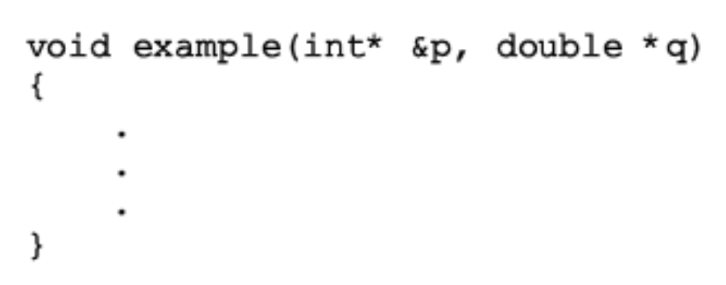
The Pointer Data Type and Pointer Variables (cont’d.)
Functions and pointers (cont’d.)
  Formal parameter as reference parameter: &
    Between data type name and identifier name
  Formal parameter as pointer: *
    Between data type name and identifier name
  Reference parameter as pointer: * &
p: pointer, reference parameter
q: pointer, value parameter
Data Structures Using C++ 2E

Slide 23
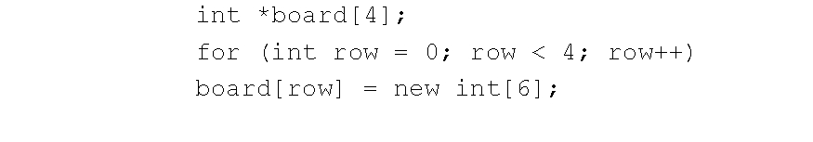
The Pointer Data Type and Pointer Variables (cont’d.)
Dynamic two-dimensional arrays
  Creation
    4 x 6: 4 rows and 6 columns
Data Structures Using C++ 2E

Slide 24
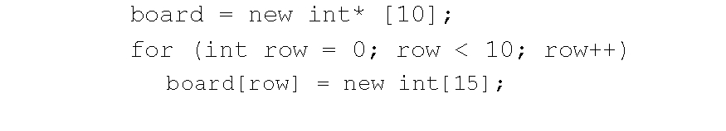
The Pointer Data Type and Pointer Variables (cont’d.)
Dynamic two-dimensional arrays (cont’d.)
  Declare board to be a pointer to a pointer
    int **board;
  Declare board to be an array of 10 rows and 15 columns
    To access board components, use array subscripting notation
Data Structures Using C++ 2E

Slide 25
The Pointer Data Type and Pointer Variables (cont’d.)
Shallow vs. deep copy
  Shallow copy: copying the pointer values only
    Two or more pointers of same type
    Points to same memory
    Points to same data
      Dangling pointer if memory is freed via the other pointer
Data Structures Using C++ 2E

Slide 26


The Pointer Data Type and Pointer Variables (cont’d.)
Shallow copy
int *first;
int *second;
FIGURE 3-16 Pointer first and its array
FIGURE 3-17 first and second after the statement
second = first; executes
FIGURE 3-18 first and second after the statement
delete [] second; executes
Data Structures Using C++ 2E

Slide 27

The Pointer Data Type and Pointer Variables (cont’d.)
Deep copy: copying both pointer values and the data they point to
  Two or more pointers have their own data
  for (int i = 0; i < size; i++)
  second[i] = first[i];
  Used in overloading assignment operator and overriding copy constructor
FIGURE 3-19 first and second both pointing to their own data
Data Structures Using C++ 2E
Notes:
Compare with shallow copy

Slide 28
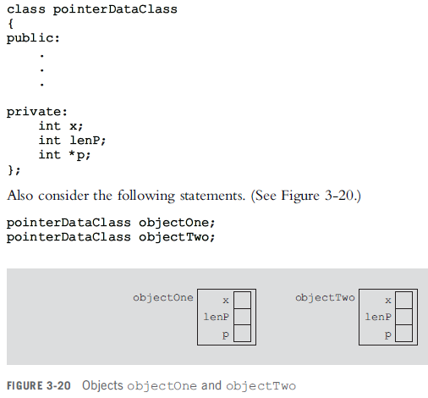
Classes and Pointers: Some Peculiarities
Class can have pointer member variables
  Peculiarities of such classes exist
What if p points to a dynamic array?
How to deallocate?
Data Structures Using C++ 2E

Slide 29

Classes and Pointers: Some Peculiarities (cont’d.)
Destructor
  Could be used to prevent an array from staying marked as allocated
    Even though it cannot be accessed
  If a class has a destructor
    Destructor automatically executes whenever a class object goes out of scope
    Put code in destructor to deallocate memory
pointerDataClass::~pointerDataClass()
{
delete [] p;
}
FIGURE 3-21 Object objectOne and its data
Data Structures Using C++ 2E

Slide 30


Classes and Pointers: Some Peculiarities (cont’d.)
Assignment operator
  Built-in assignment operators for classes with pointer member variables may lead to shallow copying of data
FIGURE 3-22 Objects objectOne and objectTwo
FIGURE 3-23 Objects objectOne and objectTwo after the statement objectTwo = objectOne; executes
Data Structures Using C++ 2E

Slide 31

Classes and Pointers: Some Peculiarities (cont’d.)
Assignment operator (cont’d.)
  Overloading the assignment operator
    Deep copy
    Avoids shallow copying of data for classes with a pointer member variable
FIGURE 3-24 Objects objectOne and objectTwo
Data Structures Using C++ 2E

Slide 32
Classes and Pointers: Some Peculiarities (cont’d.)
Copy constructor
  When declaring the class object
    Can initialize a class object by using the value of an existing object of the same type
  Default memberwise initialization
    May result from copy constructor provided by compiler
    May lead to shallow copying of data
    Solution: overriding copy constructor
  Syntax to include copy constructor in the definition of a class
  className(const className& otherObject);
Data Structures Using C++ 2E

Slide 33
Classes and Pointers: Some Peculiarities (cont’d.)
Not assignment operator executed
Copy constructor automatically executes
  when an object is declared and initialized using the value of another object of the same type
    objType a = b; // equivalent to objType a(b);
  when, as a parameter, an object is passed by value
  when the return value of a function is an object
For classes with pointer member variables
  Include the destructor in the class
  Overload the assignment operator for the class
  Include the copy constructor
Data Structures Using C++ 2E

Slide 34
Inheritance, Pointers, and Virtual Functions
Class object can be passed either by value or by reference
C++ allows passing of an object of a derived class to a formal parameter of the base class type
Formal parameter: reference parameter or a pointer
  Compile-time binding: compiler generates code to call a specific function
  Run-time binding: compiler does not generate code to call a specific function
  Virtual functions: enforce run-time binding of functions
Data Structures Using C++ 2E

Slide 35
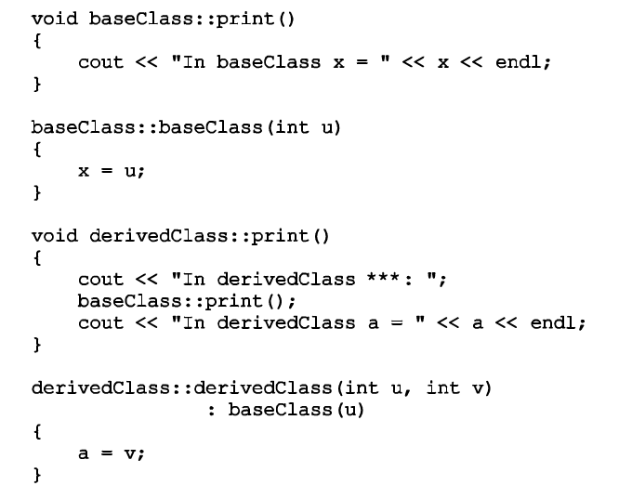
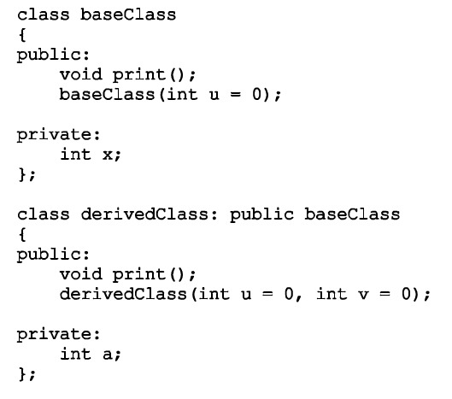
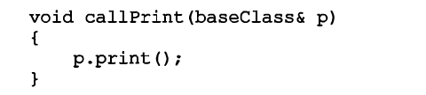
Data Structures Using C++ 2E

Slide 36
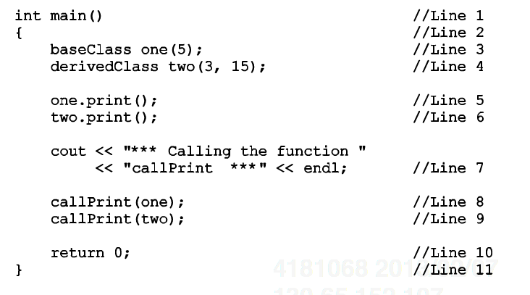
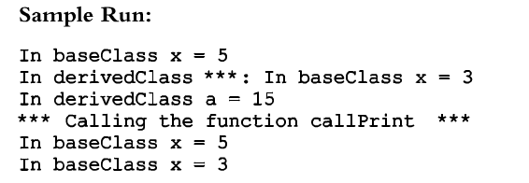
Compile-time binding
Data Structures Using C++ 2E

Slide 37
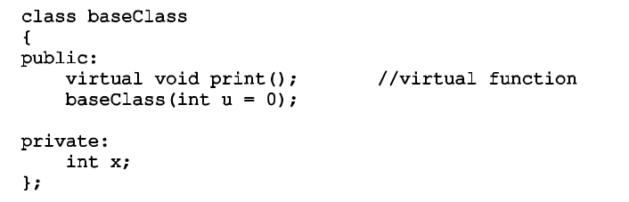
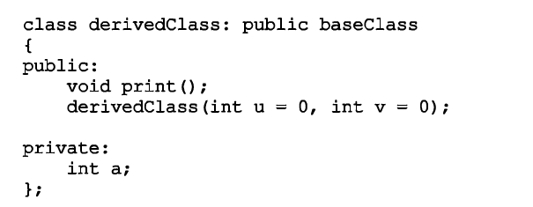
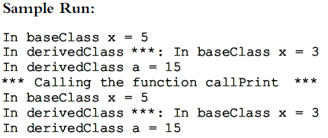
“virtual” in baseClass only
Run-time binding
Data Structures Using C++ 2E

Slide 38

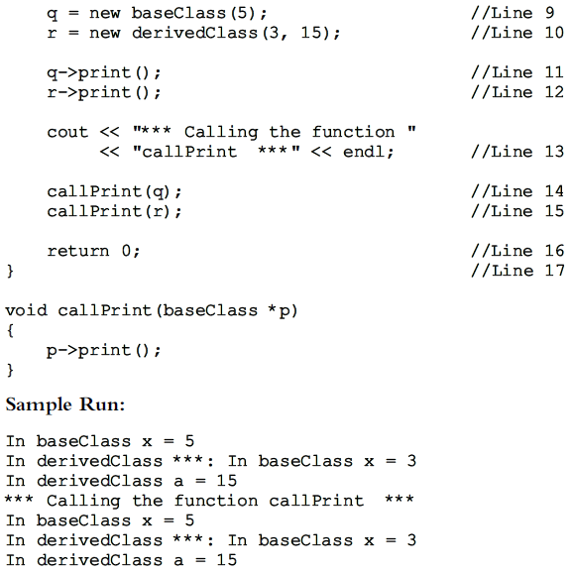
Run-time binding also applies when a formal parameter is a pointer to a class, and a pointer of the derived class is passed as an actual parameter
Run-time binding
Data Structures Using C++ 2E

Slide 39
Inheritance, Pointers, and Virtual Functions (cont’d.)
If a formal parameter of type base class is either a reference parameter or a pointer, and the function is a virtual function in the base class, we can pass a derived class object as an actual parameter and enable run-time binding
If the formal parameter is a value parameter, then the above does not work. Why?
  Value parameter (of base class type)→ the value of actual parameter is copied into formal parameter (of base class type)
Data Structures Using C++ 2E

Slide 40
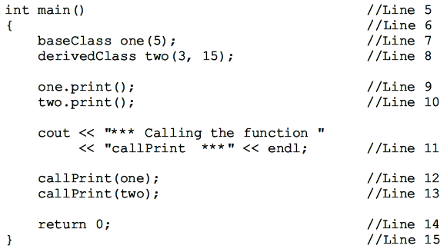
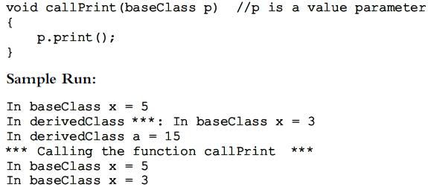
Data Structures Using C++ 2E

Slide 41
Inheritance, Pointers, and Virtual Functions (cont’d.)
Classes and virtual destructors
  Classes with pointer member variables should have a destructor
    Destructor automatically executed when class object goes out of scope
    If a derived class object is passed to a formal parameter of the base class type, base class destructor executed regardless of whether derived class object passed by reference or by value
    Derived class destructor should be executed when derived class object goes out of scope
  Solution: virtual destructor
Data Structures Using C++ 2E

Slide 42
Inheritance, Pointers, and Virtual Functions (cont’d.)
Classes and virtual destructors (cont’d.)
  Base class virtual destructor automatically makes the derived class destructor virtual
  If a base class contains virtual functions
    Make base class destructor virtual
Data Structures Using C++ 2E

Slide 43
Inheritance, Pointers, and Virtual Functions (cont’d.)
#include <iostream>
class Base
{public:
Base() {cout<<"Constructing Base\n";}
~Base(){cout<<"Destroying Base\n";}
};
class Derive: public Base
{public:
Derive(){cout<<"Constructing Derive\n";}
~Derive(){cout<<"Destroying Derive\n";}
};
void main() {
Base *basePtr = new Derive();
delete basePtr;
}
#include <iostream>
class Base
{public:
Base() {cout<<"Constructing Base\n";}
virtual ~Base(){cout<<"Destroying Base\n";}
};
class Derive: public Base
{public:
Derive(){ cout<<"Constructing Derive\n";}
~Derive(){ cout<<"Destroying Derive\n";}
};
void main() {
Base *basePtr = new Derive();
delete basePtr;
}
Constructing Base Constructing Derive Destroying Base
Constructing Base Constructing Derive Destroying Derive
Destroying Base
Data Structures Using C++ 2E

Slide 44
Abstract Classes and Pure Virtual Functions
Virtual functions enforce run-time binding of functions
Inheritance
  Allows deriving of new classes without designing them from scratch
  Derived classes
    Inherit existing members of base class
    Can add their own members
    Can redefine or override public and protected base class member functions
  Base class can contain functions each derived class can implement
Data Structures Using C++ 2E

Slide 45
Abstract Classes and Pure Virtual Functions (cont’d.)
Virtual functions enforce run-time binding of functions (cont’d.)
  Virtual functions
    Implementation is needed
  Pure virtual functions
    No implementation is needed
  Abstract class
    Class contains one or more pure virtual functions
    Not a complete class: cannot create objects of that class
    Can contain instance variables, constructors, functions not pure virtual
Data Structures Using C++ 2E

Slide 46
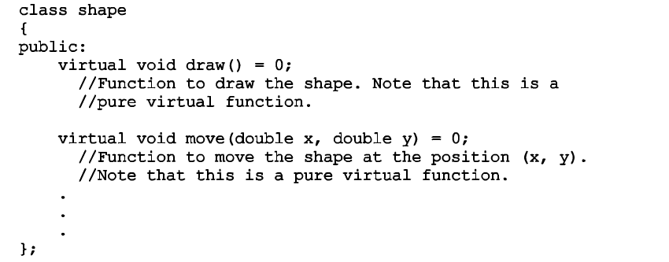
Data Structures Using C++ 2E

Slide 47
Array-Based Lists
List
  Collection of elements of same type
Length of a list
  Number of elements in the list
Many operations may be performed on a list
Store a list in the computer’s memory
  Using an array
Data Structures Using C++ 2E
Notes:
Operations: create a list, inserting an element, deleting an element, isEmpty, isFull, replacing an element, traversing the list…
Note that duplicates are not allowed!!

Slide 48
Array-Based Lists (cont’d.)
Three variables needed to maintain and process a list in an array
  The array holding the list elements
  A variable to store the current length of the list
  A variable to store array max size
Desirable to develop generic code
  Used to implement any type of list in a program
  Make use of templates
Data Structures Using C++ 2E

Slide 49
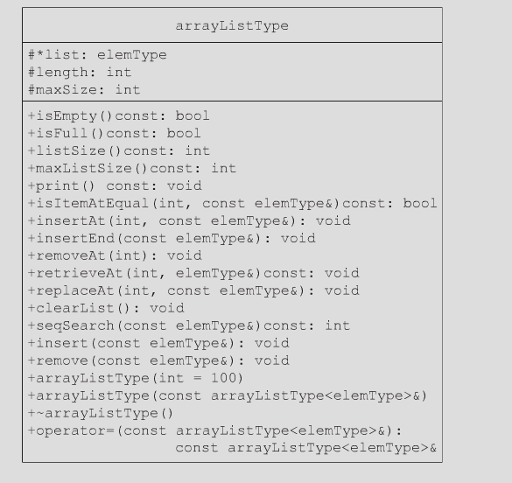
Array-Based Lists (cont’d.)
Define class implementing list as an abstract data type (ADT)
<elemType>
Data Structures Using C++ 2E

Slide 50
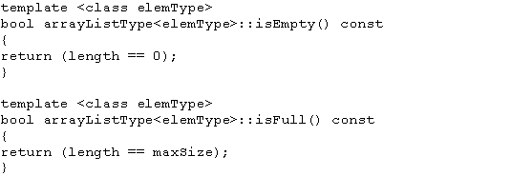
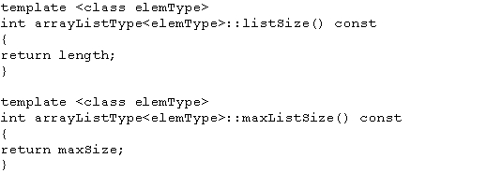
Array-Based Lists (cont’d.)
Definitions of functions isEmpty, isFull, listSize and maxListSize
Data Structures Using C++ 2E

Slide 51
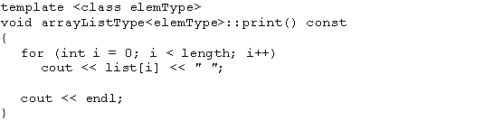
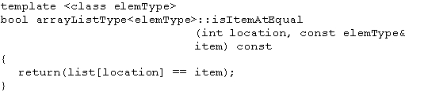
Array-Based Lists (cont’d.)
Template print (outputs the elements of the list) and template isItemAtEqual
Data Structures Using C++ 2E

Slide 52
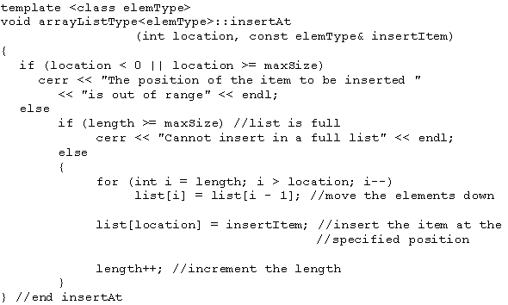
Array-Based Lists (cont’d.)
Template insertAt
Data Structures Using C++ 2E
Notes:
Use an example to show the shifting of elements, and discuss complexity of the function

Slide 53
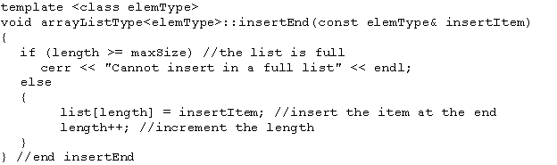
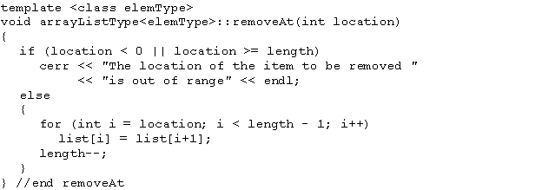
Array-Based Lists (cont’d.)
Template insertEnd and template removeAt
Data Structures Using C++ 2E

Slide 54
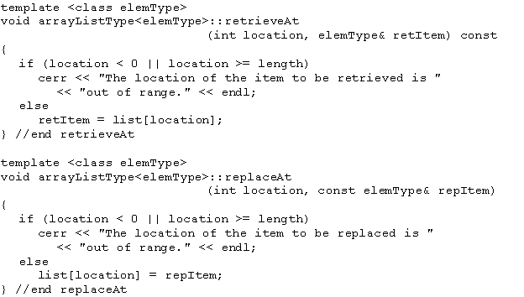

Array-Based Lists (cont’d.)
Template replaceAt and template clearList
Data Structures Using C++ 2E

Slide 55
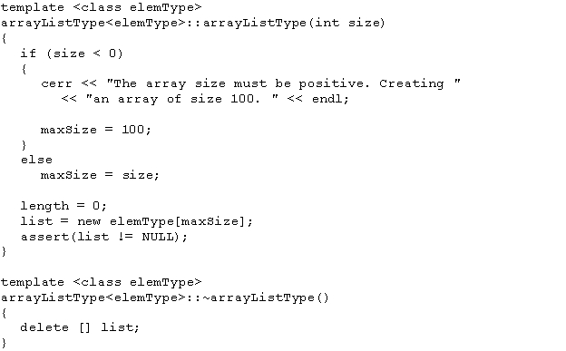
Array-Based Lists (cont’d.)
Definition of the constructor and the destructor
Data Structures Using C++ 2E

Slide 56
Array-Based Lists (cont’d.)
Copy constructor
  Called when object passed as a (value) parameter to a function
  Called when object declared and initialized using the value of another object of the same type
    Type1 a;
    …
    Type1 b = a;
  Copies the data members of the actual object into the corresponding data members of the formal parameter and the object being created (deep copy)
Data Structures Using C++ 2E

Slide 57
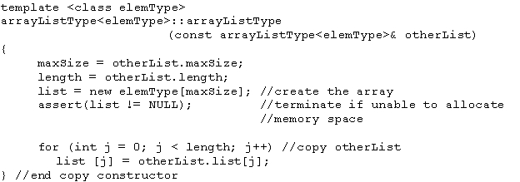
Array-Based Lists (cont’d.)
Copy constructor (cont’d.)
  Definition
Data Structures Using C++ 2E
Notes:
Why there is no “delete [] list;”? Compare this with overloading = operator (next slide)

Slide 58
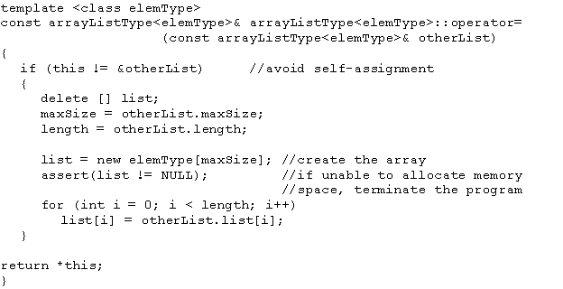
Array-Based Lists (cont’d.)
Overloading the assignment operator
  Definition of the function template
Why the return type is “const T&”?
&: to support assignment chaining a=b=c, which is right associative, a = (b = c)
const: avoid (a = b) = c
Data Structures Using C++ 2E
Notes:
Avoids self assignment
Difference of implementation of assignment operator and copy constructor
Why there is no “delete [] list;”? Compare this with overloading = operator (next slide)

Slide 59
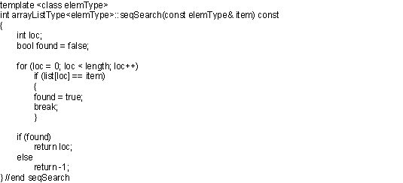
Array-Based Lists (cont’d.)
Searching for an element
  Linear search example: determining if 27 is in the list
  Definition of the function template
FIGURE 3-32 List of seven elements
Why not return bool?
Time complexity?
Can we do better?
Data Structures Using C++ 2E
Notes:
Why not return bool? This function returns the location of the item found, so it find an item at location 0 (which is false)
O(n)
Seq search O(n). Later binary search can do O(log n) for ordered list

Slide 60
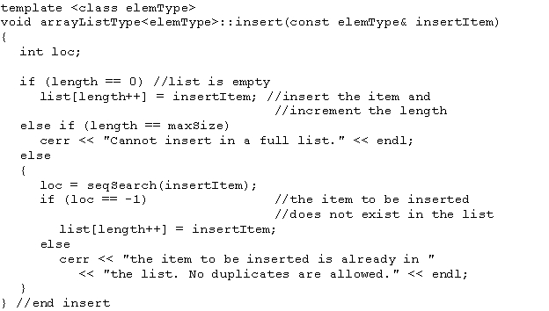
Array-Based Lists (cont’d.)
Inserting an element (duplicates not allowed)
Time complexity?
Data Structures Using C++ 2E
Notes:
Duplicates are not allowed
Time complexity: O(n)

Slide 61
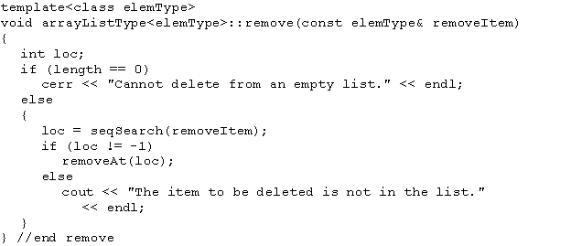
Array-Based Lists (cont’d.)
Removing an element
Time complexity?
Data Structures Using C++ 2E

Slide 62
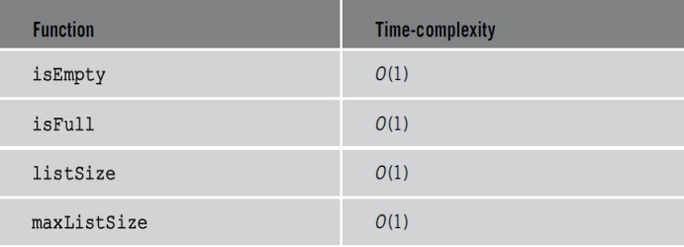
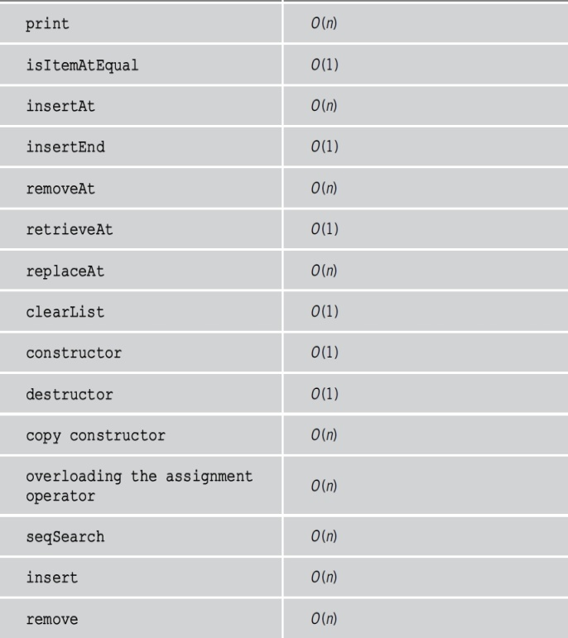
Array-Based Lists (cont’d.)
TABLE 3-1 Time complexity of list operations
Data Structures Using C++ 2E

Slide 63
Summary
Pointers contain memory addresses
  All pointers must be initialized
  Static and dynamic variables
Static and dynamic arrays
new and delete
Virtual functions
  Enforce run-time binding of functions
  Virtual destructor
Deep copy
  Overloading assignment operator
  Overriding copy constructor
Array-based lists
Template: use generic code
Data Structures Using C++ 2E

Slide 64
Self Exercises
Programming Exercises: 5, 6, 8, 9, 11, 12
Data Structures Using C++ 2E

